Slide 1
Mobile Applications Design
RESEARCH TEAM - MINSYST
Notes:
Gonzales

Slide 2
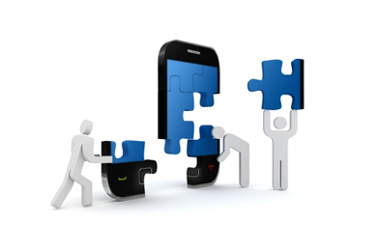
IT – 111 Team Members
Dimapilis, Joshua
Doniña, Thom
Elizondo, Kimberly
Hidalgo, Erika
Gapay, Gino
Gaoaen, Jestine
Gonzales, Nickolo
Notes:
Gonzales

Slide 3

Context
A research / a study for the design of Mobile Applications
Main Sections of the Application
Identification of key – players (e.g. youth, professionals, etc.)
Involvement of actors in Mobile Application development
Influences with regard to the construction of Mobile Apps
Methodology: Research and Analysis
Notes:
A research / a study for the design of Mobile Applications - Gapay
Social Constructionism - Hidalgo
Relevance to Significant Issues at status quo
Inception to implementation
Identification of key – players (e.g. youth, professionals, etc.) - Elizondo
Involvement of actors in Mobile Application development
Influences with regard to the construction of Mobile Apps - Dimapilis
Methodology: Research and Analysis - Gaoen

Slide 4

Discussion
Premise: In the design and development of mobile applications, several aspects of discourse are always to be considered. To fully identify the influences and to define the involvement of the actors in the construction of Mobile Applications, we must further break down the elements of Mobile App Design to research relevant information and to gather evidences.
Design
This pertains to the Mobile apps’ interface design (i.e. navigation, color schemes, fonts, etc.)
(UI / UX) User Interface and User Experience
Function
This refers to the structure of the Mobile app (i.e. app language, platforms, features, etc.)
System Design
Notes:
Premise: In the design and development of mobile applications, several aspects of discourse are always to be considered. To fully identify the influences and to define the involvement of the actors in the construction of Mobile Applications, we must further break down the elements of Mobile App Design to research relevant information and to gather evidences. - Dimapilis
Design - Doniña
This pertains to the Mobile apps’ interface design (i.e. navigation, color schemes, fonts, etc.)
(UI / UX) User Interface and User Experience
Function - Elizondo
This refers to the structure of the Mobile app (i.e. app language, platforms, features, etc.)
System Design

Slide 5
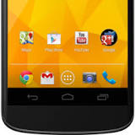
Discussion and Some Questions
Trend
This includes the involvement of the actors in the mobile apps industry
The integration of mobile apps and its role with regard to CAMSS in the Philippines
This also involves relevant issues to mobile app design (i.e. culture, power dynamics, influences)
Some questions to be answered in the study:
How does mobile application design revolutionize the way people live and how does it become an extension of a developer’s / designer‘s self?
In developing mobile applications, how much of the developer / designer’s preferences should they take in to consideration?
What triggers people with different backgrounds from the society to use mobile apps? How important is culture, influence and other social issues in designing applications?
Notes:
Trend - Hidalgo
This includes the involvement of the actors in the mobile apps industry
The integration of mobile apps and its role with regard to CAMSS in the Philippines
This also involves relevant issues to mobile app design (i.e. culture, power dynamics, influences)
Some questions to be answered in the study:
How does mobile application design revolutionize the way people live and how does it become an extension of a developer’s / designer‘s self? - Gaoaen
In developing mobile applications, how much of the developer / designer’s preferences should they take in to consideration? - Doniña
What triggers people with different backgrounds from the society to use mobile apps? How important is culture, influence and other social issues in designing applications? - Gonzales

Slide 6

Initial Findings
RESEARCH TEAM - MINSYST
Notes:
Gapay

Slide 7

Design
In designing mobile apps, the preferences / professional opinion of the designer is taken into consideration, however the customer(target market, users)’s requirements still need to be taken into consideration (on Personalized UX)
Trends seen on the internet are considered by designers as factors for designing mobile applications (i.e. Ghost buttons, Card and Flat Designs)
For UI / UX designers, it is important to have an understanding of how the product feels for the user, and how it can create the best user experience
Researching for the application’s main purpose in the field, is also vital in designing the UI and UX of the product
Example: Lumosity and Neuroscience
Notes:
In designing mobile apps, the preferences / professional opinion of the designer is taken into consideration, however the customer(target market, users)’s requirements still need to be taken into consideration (on Personalized UX) - Dimapilis
Trends seen on the internet are considered by designers as factors for designing mobile applications - Gapay
For UI / UX designers, it is important to have an understanding of how the product feels for the user, and how it can create the best user experience - Doniña
Researching for the application’s main purpose in the field, is also vital in designing the UI and UX of the product - Dimapilis
Example: Lumosity and Neuroscience

Slide 8

Function
Some points that developers believe must be considered in developing application features:
Keep it simple, prioritize speed, include analytics
Having user support is vital in mobile app development
People mostly use mobile apps rather than the web-based / website applications of the late, because of certain reasons:
Launching a mobile app is faster and more responsive than loading a mobile website;
Mobile apps can function offline and the web-based don't;
Mobile apps are easily downloaded in the Apps store;
Mobile apps enable push notifications for faster and effective way of reaching out to customer.
Notes:
Some points that developers believe must be considered in developing application features: - Elizondo
Keep it simple, prioritize speed, include analytics
Having user support is vital in mobile app development - Elizondo
People mostly use mobile apps rather than the web-based / website applications of the late, because of many reasons: - Gaoaen
Launching a mobile app is faster and more responsive than loading a mobile website;
Mobile apps can function offline and the web-based don't;
Mobile apps are easily downloaded in the Apps store;
Mobile apps enable push notifications for faster and effective way of reaching out to customer.

Slide 9
Function
Some recommended considerations in choosing a platform for mobile app development:
Your Mobile App Target Audience
Notes:
Some recommended considerations in choosing a platform for mobile app development: - Gaoaen & Elizondo
Your Mobile App Target Audience

Slide 10

Trend
Fitness and health applications are steadily becoming a trend, and therefore designers and developers should try and gear towards this shift in the mobile app market
Social businesses use the trends in mobile app design for their advantage. Mobile applications are now a part of companies‘ digital strategies
Luxury brands starting to warm to the idea of social networking.
Incredible, world-changing software innovations often come from students. Mobile application competitors are mostly college students.
Notes:
Fitness and health applications are steadily becoming a trend, and therefore designers and developers should try and gear towards this shift in the mobile app market - Gonzales
Social businesses use the trends in mobile app design for their advantage. Mobile applications are now a part of companies‘ digital strategies - Hidalgo
Luxury brands starting to warm to the idea of social networking.
Incredible, world-changing software innovations often come from students. Mobile application competitors are mostly college students. - Hidalgo

Slide 11
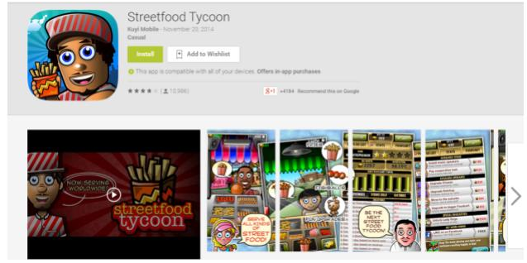
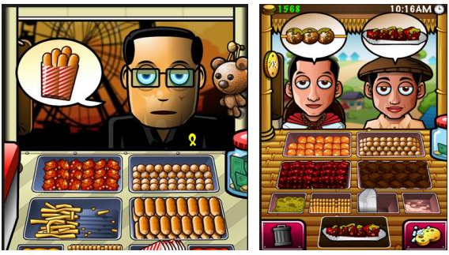
Mobile App Analysis: Streetfood Tycoon
Design
Filipino culture is present in the whole game
The UI is responsive, and may be considered as average, based on ratings
Function
In some ways, their games may be considered as ‘a rip off’ of food serving games from Y8.com
Trend
Kuyimobile, the app’s developer and uploader – are embracing the industry of mobile games, by adding a theme of Filipino Pride in their app
The basis of the app’s functions are derived from Y8.com
Notes:
TREND Team: Gonzales, Hidalgo
Design
Filipino culture is present in the whole game
The UI is responsive, and may be considered as average, based on ratings
Function
In some ways, their games may be considered as ‘a rip off’ of food serving games from Y8.com
Trend
Kuyimobile, the app’s developer and uploader – are embracing the industry of mobile games, by adding a theme of Filipino Pride in their app
The basis of the app’s functions are derived from Y8.com

Slide 12
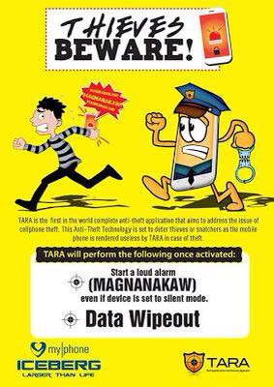
Mobile App Analysis: TARA
Design
Design is simple and is geared towards functionality
Function
T A R A : Theft Apprehension and Asset Recovery
If you activate the kill switch, the phone will scream “Magnanakaw!” non-stop.
Creating an account is as simple as registering an email account
Trend
Unfortunately, this app is only available for MyPhone users
The culture of seeking solutions to everyday problems are being incorporated in this app
Notes:
FUNCTION Team: Elizondo, Gaoaen
Design
Design is simple and is geared towards functionality
Function
T A R A : Theft Apprehension and Asset Recovery
If you activate the kill switch, the phone will scream “Magnanakaw!” non-stop.
Creating an account is as simple as registering an email account
Trend
Unfortunately, this app is only available for MyPhone users (even mobile phone companies are following the trend of having vendor – specific mobile apps)
Discuss the applications’ developer

Slide 13

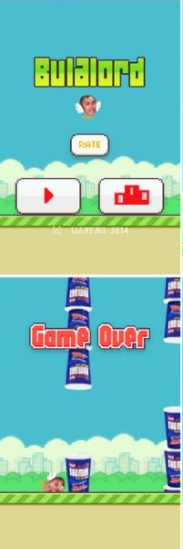
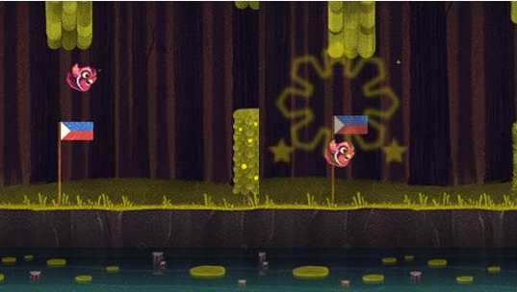
Mobile App Analysis: Pugo and Bulalord
Design
Both incorporates designs similar to the app Flappy-bird
There are some minor revisions in each app’s UI
Function
Pugo follows the same mechanic as Flappy Bird that lets you control a pink quail by tapping the screen to avoid obstacles. Bulalord Xtreme follows the same scheme as well
Trend
The “Bulalord Extreme” and “pugo” apps are clones from its original game “Flappy Bird” and based from news that became a trend in the Filipino Social Media/Community.
Notes:
DESIGN TEAM : Dimapilis, Donina, Gapay
Design
Both incorporates designs similar to the app Flappy-bird
There are some minor revisions in each app’s UI
Function
Pugo follows the same mechanic as Flappy Bird that lets you control a pink quail by tapping the screen to avoid obstacles. Bulalord Xtreme follows the same scheme as well
Trend
The “Bulalord Extreme” and “pugo” apps are clones from its original game “Flappy Bird” and based from news that became a trend in the Filipino Social Media/Community.

Slide 14

Mobile App Analysis: Summary
Streetfood Tycoon
Pugo/BXtreme
TARA
Design is based on game’s objectives
Design is based on existing game
Design is based on functionality
Vendor-specific
Design is similar to y8 games
Follows the trend shared by media
Similarities:
These apps’ functions and designs are influenced by existing mobile apps on the app store, but these possess Filipino characteristics (eg. traits, media, solutions, etc.)
Somehow these apps are an extension of the users’ values, beliefs, opinions, and desires
Key-players shaped the design of these apps based on their preferences, but for their users
Mobile apps all aim to serve their purpose for the Filipino – crowd (i.e. provide a solution, entertain, etc.)
Notes:
Venn Diagram: FUNCTION TEAM
Similarities: DESIGN TEAM

Slide 15

Interpretation of Results
Design
Personalizing UI and UX matters for this generation and the trends in designs are mostly derived from user feedback
A designer’s UI / UX are most of the time an extension of his / her beliefs, interests
Function
Developers value the users and their feedback of their application in deciding features to be included
In considering the tools, and the platform to be used, developers also take the target audience into consideration
The desires and convictions of a developer may influence his/her application
Trend
Businesses are now considering the field of mobile application development for their marketing strategies
These trends influence companies to be involved in the industry of Mobile Apps by having an app for themselves
More and more companies & government agencies are hosting competitions in Mobile App development & design.
This trend of conducting contests from idea/concept building, to long-term or short-term development has slowly invaded the IT and marketing strategies of most corporate entities here in the Philippines
Notes:
Interpretation of Results will be discussed by each team (1 Representative each)

Slide 16

Goal for Finals
Provide an output that will contribute to, and elaborate the study
Alleviate the scale of the present research
Identify important points that affect the design and development of mobile apps and the designers’ and developers’ reasons behind it
Provide more of the following, for a better pool of data to be processed/analyzed:
News articles, research / case studies, and other resources
Illustrations and graphical representations (e.g. charts, diagrams, bar graphs, etc.)
Satisfy the questions set by the group in relation to the research, with clear answers
Notes:
Provide an output that will contribute to, and elaborate the study - Gonzales
Alleviate the scale of the present research - Gonzales
Identify important points that affect the design and development of mobile apps and the designers’ and developers’ reasons behind it - Gapay
Provide more of the following, for a better pool of data to be processed/analyzed: - Donina
News articles, research / case studies, and other resources - Elizondo
Illustrations and graphical representations (e.g. charts, diagrams, bar graphs, etc.)
Satisfy the questions set by the group in relation to the research, with clear answers - Hidalgo

Slide 17

Sources:
Hill, S. (2015, February 12). Do you need antivirus on android. Retrieved from http://www.digitaltrends.com/mobile/do-you-need-antivirus-on-android/
Hou, O. (2012, July 20). A Look at Google Bouncer. Retrieved from http://blog.trendmicro.com/trendlabs-security-intelligence/a-look-at-google-bouncer/
Boxall, Andy. (2014, December 11). 2014 is the year of health and fitness apps. Retrieved from http://www.digitaltrends.com/mobile/google-play-store-2014-most-downloaded-apps/
Emerging Trends in Mobile and What They Mean for Your Business. (2014. August 05) Retrieved from http://www.nielsen.com/us/en/insights/news/2014/emerging-trends-in-mobile-and-what-they-mean-for-your-business.html * Mobile Phones.(2014) Retrieved from http://www.saferinternet.org/online-issues/parents-and-carers/mobile-phones
Gerber, S. (2012, December 16). 13 must-have features for your next mobile app. Retrieved from http://thenextweb.com/entrepreneur/2012/12/16/13-must-have-features-for-your-business-mobile-app/
Mobile Applications in the building and construction industry. Retrieved from http://www.functionatl.com/media/support_images/Function_Mobile_Apps_Research.pdf
Mobile App 101: Key Functions to Consider.(2013, January 28). Retrieved from http://www.rainmaker-labs.com/mobile-app-key-functions/
UI, UX: Who Does What? A Designer's Guide To The Tech Industry. (2014, July 07). Retrieved from http://www.fastcodesign.com/3032719/ui-ux-who-does-what-a-designers-guide-to-the-tech-industry
Steve, C. .How to Design a Killer Mobile Ecommerce Website that will Boost Sales. Retrieved from http://mywifequitherjob.com/how-to-design-a-killer-mobile-ecommerce-website-that-will-boost-sales/
J, F. (2014, January 17). Lalaking naghahanap ng bulalo soup sa panaderya, nagwala nang bigyan ng cup noodles na bulalo flavor. Retrieved March 1, 2015, from http://www.gmanetwork.com/news/story/344328/ulatfilipino/balitangpinoy/lalaking-naghahanap-ng-bulalo-soup-sa-panaderya-nagwala-nang-bigyan-ng-cup-noodles-na-bulalo-flavor

Slide 18
Sources:
Wondrack, J..(2015, February 25). A Common Design Taxonomy. Retrieved from http://uxmag.com/articles/a-common-design-taxonomy Tyson, J..(2015, February 19).If You Build it (Right) They Will Come Lessons in successful consumer products from the DfE awards. Retrieved from http://uxmag.com/articles/if-you-build-it-right-they-will-come
Tan, A. (2015, February 9). How to Choose the Best Platform for Your Mobile App? Retrieved March 1, 2015, from https://www.smaato.com/how-to-choose-the-best-platform-for-your-mobile-app/
IDC: Smartphone OS Market Share. (n.d.). Retrieved March 1, 2015, from http://www.idc.com/prodserv/smartphone-os-market-share.jsp
Luces, K/JDS. GMA News. Pinoy Flappy Bird-inspired game Pugo is top pick on AppStore Retrieved from http://www.gmanetwork.com/news/story/350722/scitech/geeksandgaming/pinoy-flappy-bird-inspired-game-pugo-is-top-pick-on-appstore/
Imagine Cup 2014 Winners. (2014). Retrieved from https://www.imaginecup.com/Custom/Index/2014Winners_Finals
Castillo, W. (2015, January 30). Voices: Do companies take college student app developers seriously?. Retrieved from http://college.usatoday.com/2015/01/30/voices-do-companies-take-college-student-web-developers-seriously/
Anderson, T.(2015, February 16).What does the rise of digital marketing mean for luxury brands?. Retrieved from http://www.theguardian.com/marketing-luxury-goods-feb-15/2015/feb/16/digital-marketing-luxury-brands
Fadeyev, D..(2008, December 15). 10 Useful Techniques To Improve Your User Interface Designs. Retrieved from http://www.smashingmagazine.com/2008/12/15/10-useful-techniques-to-improve-your-user-interface-designs/
Kuyimobile.com
Thank you!
Notes:
Conclusion – Dimapilis
Closing - Everyone

